Slide 1

Lecture 2
Getting data into SAS
Matthew Valentine
Office: Tech Room Lab K2
mvalentine@uwc.ac.za

Slide 2

Learning objectives
To enter data using freeform list input
To enter data using compact method
To enter data using column input
To enter data using formatted input
To enter data using the infile technique
To enter multiple-line data

Slide 3
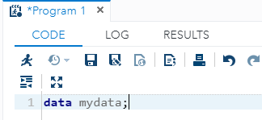
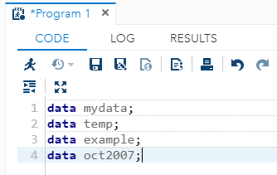
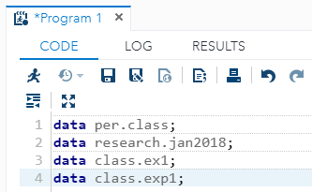


Using the SAS data sets
In SAS the DATA statement signals the creation of a new dataset.
A DATA statement in SAS code may look like this…
Example;
The keyword DATA tells SAS to create a new data set. The word MYDATA in the DATA statement is the name assigned to the new data set.
The SAS data set name can be a single name (Used for Temporary data sets, those kept only during the current SAS session)
Example;
The SAS data set name can be a two part name. The two part name tells SAS that this Permanent data set will be stored on disk beyond the current SAS session in a SAS library indicated by the prefix name.
Example;
PER.CLASS

Slide 4
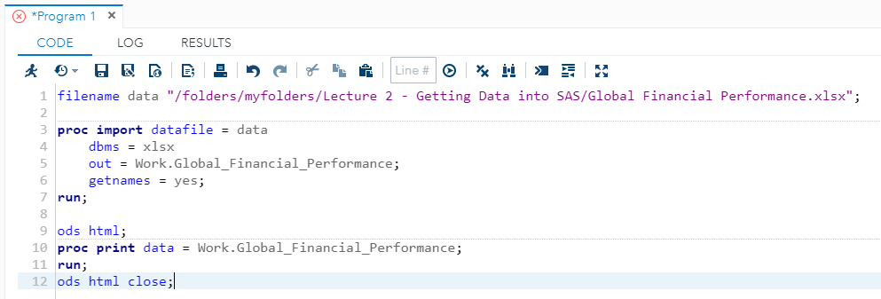
Importing a dataset into SAS
FILENAME – Specifies the complete path and filename for the input PC file, Example; Spreadsheet. It is associated with the physical location of the output file. (Temporary Data set)
PROC IMPORT – Reads data from an external data source and writes it to a SAS data set.
DBMS – Specifies the type of data to import, such as XLSX or CSV.
OUT – Identifies the output SAS data set with either a one or two level SAS name.
GETNAMES – Specifies that you would like to use the external files Variable names.
ODS HTML – Output Delivery System (ODS) is a feature that allows you to enhance your SAS output. Normally SAS output appears in the Output window. ODS RTF, ODS PDF…
PROC PRINT – Outputs a listing of the data values in a SAS dataset.

Slide 5
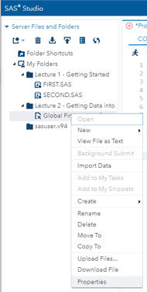
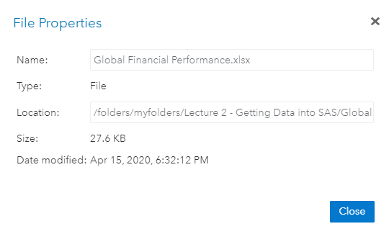
Importing a dataset into SAS
Make sure that you create a folder called Lecture 2 – Getting data into SAS and upload the dataset called Global Financial Performance.
Right click on the Global Financial Performance Dataset and click on “Properties”. Then copy the location Path and paste in the editor.

Slide 6
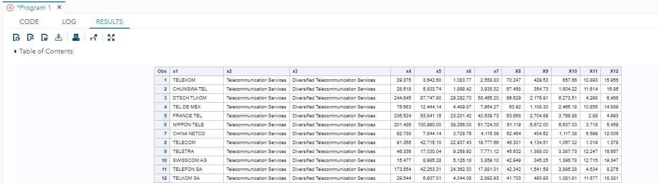
Understanding SAS data set Structure
Once you read data into SAS, the program stores the data values as a data set (Also called a data table) as a collection of data values arranged in a rectangular table.
This can be found in the results table.
Differences in SAS table from a regular Excel Spreadsheet;
Each Column represents a variable and is designated with a variable name.
Each Row, marked here 1, 2, 3…n, indicates observations or records.

Slide 7


Rules for SAS variable Names
Must be 1 – 32 characters long but must not include any blanks.
Must start with the letters A – Z or an underscore (“_”). A name may not include a blank.
May include numbers (but not as the first character.
May include upper and lowercase characters (Variable names are case-insensitive)
Should be descriptive of the variables (Optional but recommended)
Example of Correct Variable names;
GENDER
AGE_IN_1999
AGEin1999
_OUTCOME
Example of Incorrect Variable names;
AGE IN 2000
2 0 0 0MeaslesCount
S S Number
AGE-In-2000

Slide 8
SAS Naming Examples
GENDER
Gender
_Age
A_G_E
1ONE
MY DATASET

Slide 9
Understanding Three SAS variable Types
Number – A numeric variable is used to designate values that could be used arithmetic calculations or grouping codes for categorical variables.
Character – (Text, String) are used for values that are not used in arithmetic calculations.
Date – A date value may be entered into SAS using a variety of formats such as;
10/15/09
01/05/2010
JAN052010

Slide 10
Methods of reading data into SAS
Reading data using freeform list input
Reading data using the compact method
Reading data using column input
Reading data using formatted input

Slide 11
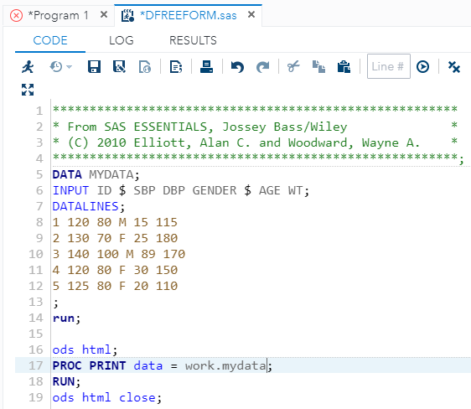
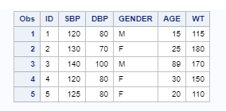
Reading data using Freeform List Input
In this method variable names in the DATA step are indicated by a list following the INPUT statement keyword
Example;
The INPUT statement tells SAS the names of the variables in the data set.
Notice the $ following the variable GENDER. In Freeform input, this indicates to SAS that the variable GENDER is of a character type.
You have to then tell SAS how to find and read in the data. The special keyword used is called DATALINES, which tells SAS that the upcoming lines contain data.
The first line of code contains the data for a single subject.
The first data value (1) in that lines corresponds to the first variable (ID) in the INPUT Statement.
DATA MYDATA;
INPUT ID $ SBP DBP GENDER $ AGE WT;
Open SAS Program DFREEFORM.SAS

Slide 12
Advantages of Freeform List Input
Its easy, little to specify.
Its rigid column positions are not required, making data entry easy.
If you have a data set in which the data are separated by blanks, this is the quickest way to get your data into SAS.
Disadvantages of Freeform List Input
Every variable on each data lines must be in order specified by the INPUT statement.
Data values must be separated by at least on blank.
Blank spaces representing missing variables are not allowed. If you do have missing values within the data set, a (.) should represent the missing value.
Open SAS Program DFREEFORM.SAS

Slide 13
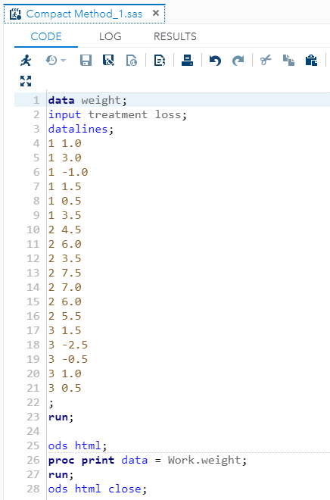
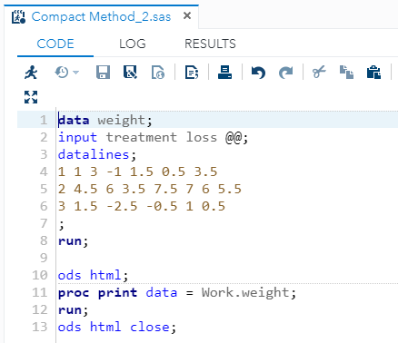
Reading data using the Compact Method
This method is regarded as the second version of the Freeform List, it allows you to have several subjects data on a single line.
A typical Freeform data set would look like this;
To save space, the data can be compared using an @@ option in the INPUT statement to tell SAS to continue reading each line until it runs out of data.

Slide 14
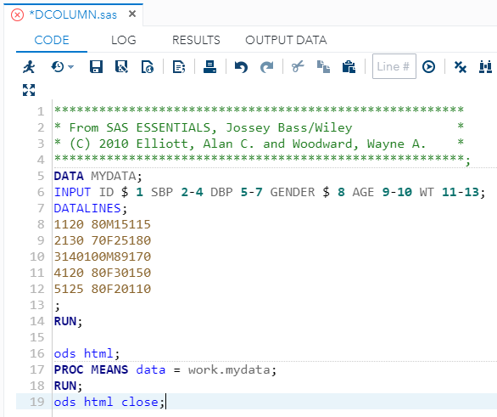
Reading data using the Column Input
This data entry technique should be used when your data consists of fixed columns of values that are not necessarily separated by blanks. For example;
Notice that the primary difference between this column INPUT statement and the freeform list INPUT statement is the inclusion of column ranges telling SAS where in the data set to find the information for each variable.
SAS allows you to specify which columns in the raw data set contain each variable’s values. You must know the starting column and ending columns for each variable’s values.
Open SAS Program DCOLUMN.SAS

Slide 15
Advantages of Column Input
Blanks are not needed to separate fields
Character values can range from 1 to 200 characters. For example;
For character values, embedded blanks are not problem (Eg., John Smith)
INPUT SBP 2-4
Disadvantages of Column Input
Data values must be fixed column positions
Banks fields rea as missing
Character fields are read right-justified in the field
Column input has more specifications than list input
You must specify the ranges for each variable

Slide 16
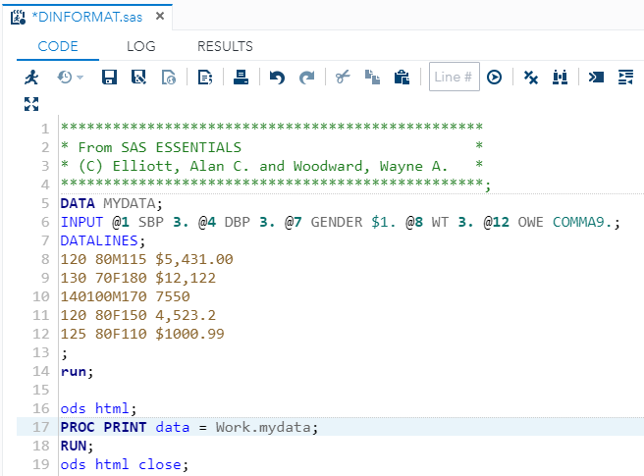
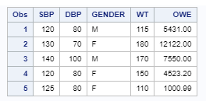
Reading data using Formatted Input
This technique allows you to specify information about how SAS will interpret data as they are read into the program.
SAS uses the term INFORMAT to specify an input specification that tells it how to read data.
Using an INFORMAT is helpful when you are reading data that might be in a otherwise hard-to-read format, such as data and dollar values.
The Pointer – (The @ sign) tells SAS to read data for this variable beginning in the indicated column.
The variable name – (SBP) tells SAS that the name of this first variable is SBP.
The INFORMAT (3.) tells SAS that data at this location in each row are numbers containing three digits.
Open SAS Program DINFORMAT.SAS

Slide 17
Examples of SAS formats
Format | Raw value | Read As
Comma7. | $40,000 | 40000
Comma10.2 | 190,020.22 | 190020.22
Dollar10.2 | $19020.22 | 19020.22
Date9. | 12JAN1999 | SAS numeric value

Slide 18
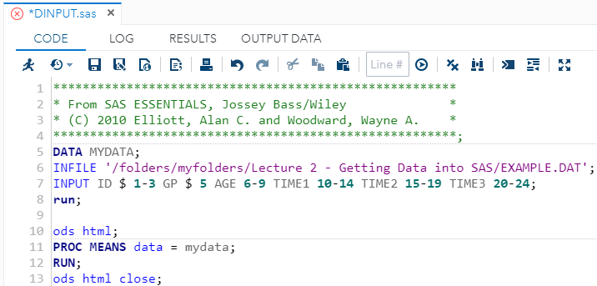
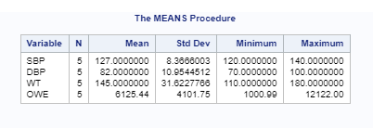
Reading external data using Infile statement
The INFILE statement is used to identify an external ASCII (Text) file in SAS. Its is an alternative to the DATALINES statement.
Notice that the INFILE statement must appear in the code before the INPUT statement that reads the data lines. When you run this code produces the following output.

Slide 19
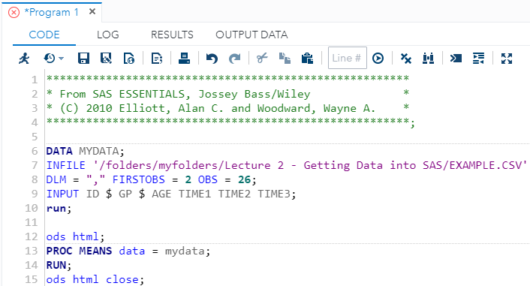
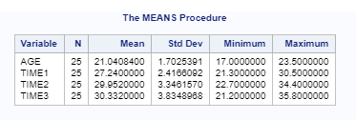
Using Advanced INFILE statement options
DLM – specify the delimiter to be used (e.g. “,”)
DSD – Instructs SAS to recognize two consecutive delimiters as a missing value. For example, the information M, 15, , 115 would be read as M, 15, MISSING, 115.
MISSOVER – moves to the next line to fill up the observation’s variable values
FIRSTOBS – specify the starting point
OBS – specifies the last observation point
Open SAS Program DINPUT.SAS

Slide 20
Study
Chapter 2
Matthew Valentine
Office: Tech Room Lab K2
Mvalentine@uwc.ac.za

